Slide 1
CoE-IHS Equity in Action: Working Towards Health Equity with Wellbeing and Self-Compassion In Mind
Thursday, December 14th, 2023
12-1pm ET

Slide 2
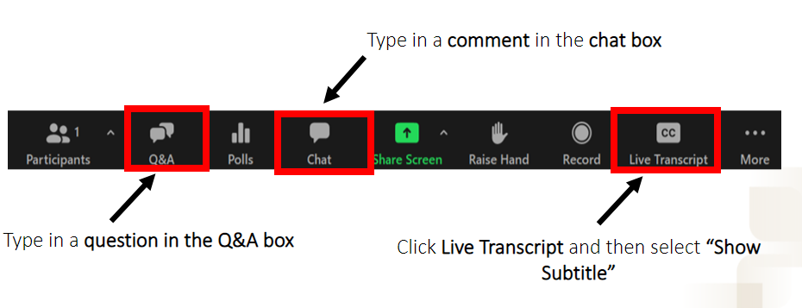
Questions, Comments & Closed Captioning

Slide 3
Disclaimer
The views, opinions, and content expressed in this presentation do not necessarily reflect the views, opinions, or policies of the Center for Mental Health Services (CMHS), the Substance Abuse and Mental Health Services Administration (SAMHSA), or the U.S. Department of Health and Human Services (HHS).
www.samhsa.gov

Slide 4
Introductions
Moderator: Dr. Ami Roeschlein, Consultant, Practice Improvement & Consulting, National Council
Panelists:
Dr. Laura Leone, DSW, MSSW, LMSW, Consultant, National Council for Mental Wellbeing
Dr. Mari Aceves, EdD, DSW, BCBA, Consultant, Trauma-Informed Resilience-Oriented, Equity-focused Services, National Council for Mental Wellbeing
Health Equity Faculty Panelists
Dr. Terence Fitzgerald, Consultant, Trauma-Informed, Resilience-Oriented Services, Center of Excellence for Integrated Health Solutions
Dr. Pierluigi Mancini, President, Multicultural Development Institute
Notes:
[insert bios here]
Ivanova Smith, Rights Activist, Chair of Self Advocates in Leadership (SAIL) and Advocate Faculty at the University of Washington Leadership Education in Neurodevelopmental and Related Disabilities (LEND) Program

Slide 5
End of Session Poll Questions
See pop up box for 3 poll questions.

Slide 6
Health Equity Tools & Resources
Center of Excellence for Integrated Health Solutions
Access for Everyone: A Toolkit for Addressing Health Equity & Racial Justice within Integrated Care Settings
Social Justice Leadership Academy (SJLA) Workbook
Racial Equity Tools
Diversity, Equity & Inclusion Framework
Racial Equity Toolkit
Rasing the Bar (RtB) Framework
Health Equity and Racial Justice Webpage
National Council for Mental Wellbeing
See our page for more information on Webinars and Upcoming Events, Resources and Tools, and Training and Technical Assistance focused
on Health Equity and Racial Justice

Slide 7
Tools & Resources
Self-Compassion-for-the-Holidays_2023-PDF
Center of Excellence for Integrated Health Solutions
Self-Compassion for Healthcare Communities (SCHC)
Center for Mindful Self-Compassion
Teaching the Mindful Self-Compassion Program: A Guide for Professionals
Previous sessions
Leadership Check-Up Series: Avoiding COVID-19 Burnout: Self-Care and Resiliency for Public Health Leaders- (Sept. 2020)
Leadership Check-Up Series: Avoiding COVID-19 Burnout: Self-Care and Resiliency for Public Health Leaders (Second Offering)- (Nov. 2020)
COVID-19 Office Hours: Promoting Organizational and Self-Care Strategies for African Americans- (June 2020)
Strategies for Building Compassion Resilience in Integrated Care Settings- (Oct. 2021)

Slide 8
Are You Ready to INSPIRE Change? Join Us As a Panelist!
Upcoming Events
I
Integrated Care to Support the Impacts of Global Conflict
January 17th, from 1-2pm ET
Celebrating Black Excellence
February TBD
TBD
March TBD
Complete brief survey to submit interest in being a panelist!

Slide 9
Upcoming Events
Dec.
21
from 2-3pm ET
CoE-IHS Webinar: Pediatric Integration Opportunities in Early Childhood
Register Here
Jan.
17
from 1-2pm ET
CoE-IHS EIA: Integrated Care Support the Impacts of Global Conflict
Register Here
Relias On-Demand Training
Learn More
Subscribe for Center of Excellence Updates​
Subscribe Here

Slide 10
CHAT WITH AN EXPERT!
Schedule a free call with an integrated care expert to discuss:
Health Equity through Integrated Care
Workforce Development
Integrated Care Financing & Operations
Implementing Models of Integrated Care
Population Health in Integrated Care
Diversity, Equity and Inclusion
Ongoing Impacts of COVID-19 Pandemic
Submit a Request!
Notes:
Sarah
Integration with Schools & Social Services
Rural Health Integration
Perinatal Integration

Slide 11
Thank You
Questions?
Email integration@thenationalcouncil.org
SAMHSA’s Mission is to reduce the impact of substance abuse and mental illness on America’s communities.
www.samhsa.gov
1-877-SAMHSA-7 (1-877-726-4727) 1-800-487-4889 (TDD)

