Slide 1
Reimagining Behavioral Health Workforce Pathways: An Introduction to Apprenticeships
Thursday, September 19
2 PM ET

Slide 2
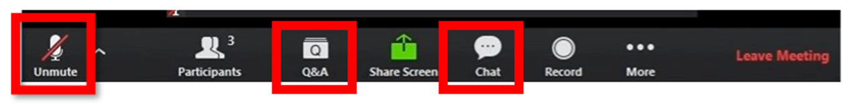
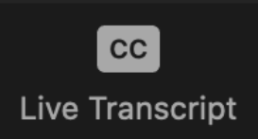
Asking A Question & Using Closed Captioning
All functions are located at the bottom of your screen​​
Ask questions by using the Q&A function​ (you will not be able to unmute). Please indicate if you would like your questions to be anonymous.
Use the chat for discussion & interactive activities​.
Click and then select "Show Captions" to access closed captioning or "View Full Transcript" to access the transcript.
*If you are experiencing technical difficulties, please send a direct Zoom chat message to Hosts and Panelists.
*Webinar slides and recording will be posted on the website following the event's conclusion
Notes:
Briefly explain long-standing challenges
Mention harris poll

Slide 3




Today's Presenters
Kevin Comeau
Project Director
National Council for Mental Wellbeing
Rachel Kessler
Project Manager
National Council for Mental Wellbeing
Lauren Smith
Apprenticeship Training Program Specialist
US Department of Labor
Madeline Boehm
Program Manager
Healthcare Career Advancement Program (H-CAP)
Notes:
Briefly explain long-standing challenges
Mention harris poll

Slide 4

Long-Term Challenges in Workforce
Inadequate reimbursement for behavioral health services.
Financial burden and affordability of advanced education with low career salaries.
Growing regional professional shortages, creating gaps in care nationally.
Lack of a sustainable workforce and long-term strategy for developing the workforce.
Lack of diversity among professionals and representation of communities served.
Regulation and administrative burden challenges.
High workloads, secondary trauma and wellness concerns.
Notes:
Briefly explain long-standing challenges
Mention harris poll

Slide 5
What else does the data tell us?
Our workforce remains passionate yet fatigued.
Despite challenges created by the workforce shortage, a majority of those in the behavioral health field remain passionate about and fulfilled by their work. Nearly all employees are satisfied with their ability to make a difference for their clients (96%) and to help others at their current job (95%).
We need solutions now.
The shortage shows no sign of easing. "Substantial shortages of addiction counselors, marriage and family therapists, mental health counselors, psychologists, and psychiatrists are projected in 2036." (HRSA)
Notes:
Highlight optimistic view of change – but need for action

Slide 6


The Center for Workforce Solutions
A collective impact initiative to revolutionize the mental health and substance use treatment workforce.
Mission: The Center for Workforce Solutions (CWS) brings together cross-sector partners to identify, elevate, and scale innovative solutions for persistent behavioral health workforce challenges. Through an equity-grounded shared strategy, advocacy, and training and technical assistance, we amplify effective solutions and drive systemic change.
Vision: A behavioral health system where timely, high-quality services are provided by an inclusive, accessible, sustainable, and thriving workforce.
Notes:
Systems Change – Long-term approach to addressing the WF crisis
Highlight the partnership and how we've been working together since 2016
The CWS is a national partnership to build cross-sector efforts to identify, expand, and scale effective behavioral health workforce solutions.

Slide 7
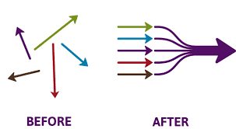
The Center for Workforce Solutions
Moving to ACTION
Determine shared priorities
Engage organizations in working together
Leverage various strengths across partners
Reach more areas of work through collective effort
Notes:
CWS believes that a root cause of the problem has been sectors working on small pieces of the puzzle but ultimately remaining fragmented in solutioning.
Recommendations require strong accountability for implementation (which historically have been dispersed across sectors leading to no accountability).

Slide 8
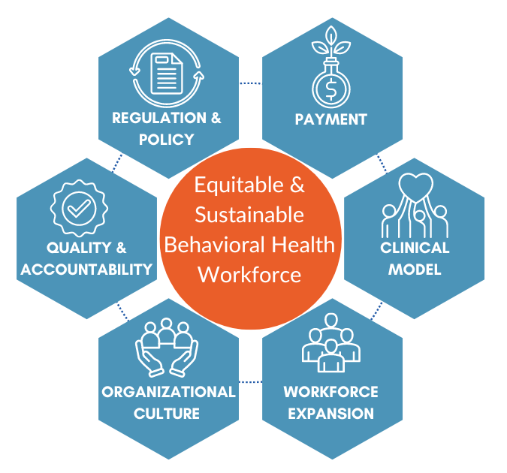

Levers of Change
Regulation and Policy: Reforming existing regulations and policies to support workforce expansion and promote equity within the behavioral health sector.
Payment Models: Developing sustainable payment structures that ensure fair compensation for behavioral health workers, thereby attracting and retaining talent.
Clinical Models: Innovating clinical practices to enhance workforce efficiency and job satisfaction, leading to better patient outcomes.
Workforce Expansion: Increasing the size and diversity of the workforce to better represent and serve diverse communities across the country.
Organizational Culture: Fostering a supportive workplace environment that prioritizes staff well-being and retention through effective leadership and organizational practices.
Quality and Accountability: Implementing data-driven strategies to measure and improve workforce outcomes, ensuring accountability and continuous improvement
Notes:
working at multiple levels of the system to execute solutions in concert to tackle complex recommendations and achieve meaningful impact.
WF expansion is a focus of today - is the key lever to building behavioral health resources that are more representative of communities and creating systems that are grounded in equity.

Slide 9
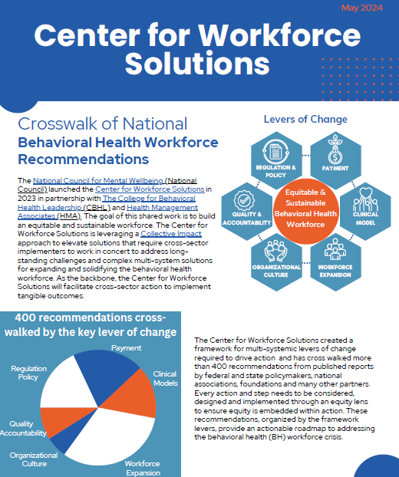
Crosswalk of National Behavioral Health Workforce Recommendations
CWS compiled more than 400 recommendations from published reports by federal and state policymakers, national associations, foundations and other partners and stakeholders to serve as an actionable roadmap for addressing the behavioral health workforce crisis.
Organizations can explore the crosswalk summary, organized by key areas of change, to see where they can act toward creating a stronger, more equitable workforce.
You can download the resource on our website!
Notes:
WF expansion had most recommendations

Slide 10
Crosswalk of Recommendation Highlights: Workforce Expansion
Expanding both the clinical and non-traditional workforce are central to addressing current and future shortages and are part of clinical innovation and new models of care.
Recruit and retain a diverse and inclusive healthcare workforce
  Develop equity-grounded leadership programs to build leadership and expansion of a diverse workforce and foster clear, equitable pathways for career advancement
Enhance the infrastructure available to support and coordinate workforce development
  Implement systematic recruitment and retention strategies at the federal, state, and local levels
  Build relationships with the community, local colleges and universities to raise connection with diverse students who could become part of the workforce pipeline
  Design models for training, including how to receive payment and invest in Peer run organization policy, payment, and training
Expand and optimize the workforce
  Develop a greater role for peer specialists, community health workers, and paraprofessionals to free up the licensed workforce for those with higher level needs
Notes:
Examples here – tie into work-based learning and apprenticeships are

Slide 11
NCMW Apprenticeship Capacity Building Project
Survey – Contextualize environmental scan findings in real occupational settings
Focus Groups – Hear from organizations with experience implementing a RAP/ WBLP
Environmental Scan – Understand the MH/SU landscape of RAPs and WBLPs
Initial Findings:
There is a lack of awareness of RAPs in the MH/SU field but an interest in learning more
Barriers to implementing a RAP include understanding the registration process, lack of funding, lack of organizational capacity to commit to the program
WBLPs experienced challenges including turnover and staffing difficulties
RAPS/WBLPs can be beneficial for staff recruitment/retention, increasing
employee skill level and increasing workforce capacity to serve clients

Slide 12

Coming Soon: Work-Based Learning Handbook
This handbook will include:
Overview of Registered Apprenticeship Programs (RAP)
Overview of work-based learning programs
Program considerations surrounding funding, recruitment and retention, and ROI
Resources to support organizations interested in exploring implementation of a RAP or work-based learning program
Discussion of the importance of equity
in the MH/SU workforce

Slide 13


WHAT IS APPRENTICESHIPUSA?
ApprenticeshipUSA is a unifying brand designed to connect,
unite, and amplify all stakeholders in the national Registered Apprenticeship system including apprenticeship sponsors,
training providers, apprentices, Office of Apprenticeship staff,
State Apprenticeship Agencies, employers, labor management organizations, industry associations, educators, equity partners,
and others under one name.
This initiative supports the Department’s broader efforts to expand, diversify, strengthen, and modernize Registered Apprenticeship.

Slide 14
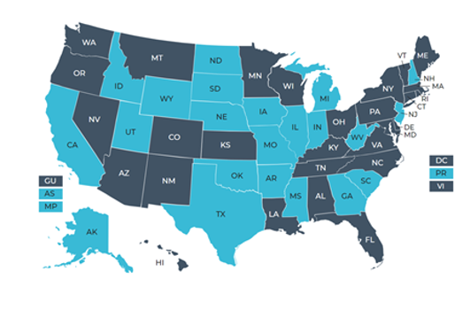
THE REGISTERED APPRENTICESHIP SYSTEM
The Office of Apprenticeship oversees the National Registered Apprenticeship System, which involves employers, industry associations, labor, education providers, Apprenticeship Industry Intermediaries, State Apprenticeship Agencies, and other Registered Apprenticeship stakeholders and sponsors. There are Registered Apprenticeship experts in every state who are available to assist organizations interested in developing Registered Apprenticeship programs.

Slide 15

ABOUT US
886K+
23K+
7,454
85%
FY 2023
FAST FACTS
Apprentices served
Active apprenticeship programs
New apprenticeship programs since 2021
Growth of new apprentices over the past decade
OUR MISSION
The U.S. Department of Labor’s Office of Apprenticeship promotes and oversees quality, accessible Registered Apprenticeship opportunities for workers seeking higher-skilled, higher-paying jobs and engages employers seeking to build a qualified, diverse, and inclusive workforce.
Learn more at Apprenticeship.gov

Slide 16

BENEFITS OF
REGISTERING YOUR PROGRAM
By registering your program with the U.S. Department of Labor or State Apprenticeship Agency, you will gain access to additional resources:
Access to a nationwide network of expertise, customer service, and support at no charge.
Access funding and other resources from federal programs. In many states, businesses can qualify for tax credits.
Graduates receive an industry-recognized and nationally-portable credential.

Slide 17

REGISTERED APPRENTICESHIP HAS A PROVEN TRACK RECORD OF PRODUCING STRONG RESULTS FOR EMPLOYERS AND WORKERS
IMPRESSIVE INDIVIDUAL – EMPLOYEE –
PUBLIC RETURN ON INVESTMENT
44.3%
Employer return on investment in Registered Apprenticeship
94%
Of those that complete their apprenticeship retain employment after completion.
$28
In benefits for every $1 invested by the government
$80K
$300K+
Completers earn per year on average
Apprentices’ lifetime earning advantage
Data provided by www.apprenticeship.gov

Slide 18


Employers report these indirect benefits of their apprenticeship programs
Improved company culture
96%
Improved pipeline of skilled workers
91%
Improved employee loyalty
91%
Improved co-worker productivity
87%
Reduced turnover
81%
Product
or process innovation
78%
Future manager development
76%
Increased
on-time delivery
74%
Reduced downtime
68%
Notes:
Findings from the Evaluation of the American Apprenticeship Initiative (AAI) offer insight into the benefits
to employers of using Registered Apprenticeship programs to hire and train workers. To measure employer
benefits, the AAI evaluation team surveyed 68 employers affiliated with AAI grantees and generated two
measures of benefits to employers: return on investment (ROI) of apprenticeship and net benefits of
apprenticeship.
Employers gain indirect benefits from registered apprenticeship investments, such as reduced staff turnover, improved work culture, enhanced co-worker productivity, and having a pipeline of skilled workers. The AAI Employer Survey inquired about 10 indirect benefits. Rather than assigning a dollar value, employers reported whether they experienced the benefit and the value of the indirect benefit relative to direct benefits (e.g., 50% as important, 100%, 150%).
Employer net benefits are higher when indirect benefits of registered apprenticeships are included.
Median net benefits using both direct and indirect benefits for the full apprenticeship and post-apprenticeship period were $17,862. When using direct benefits only, the median employer lost $4,951.
Most employers reported experiencing 9 of 10 indirect benefits, which underscores the value of including indirect benefits when assessing net benefits to employers of registered apprenticeship.

Slide 19




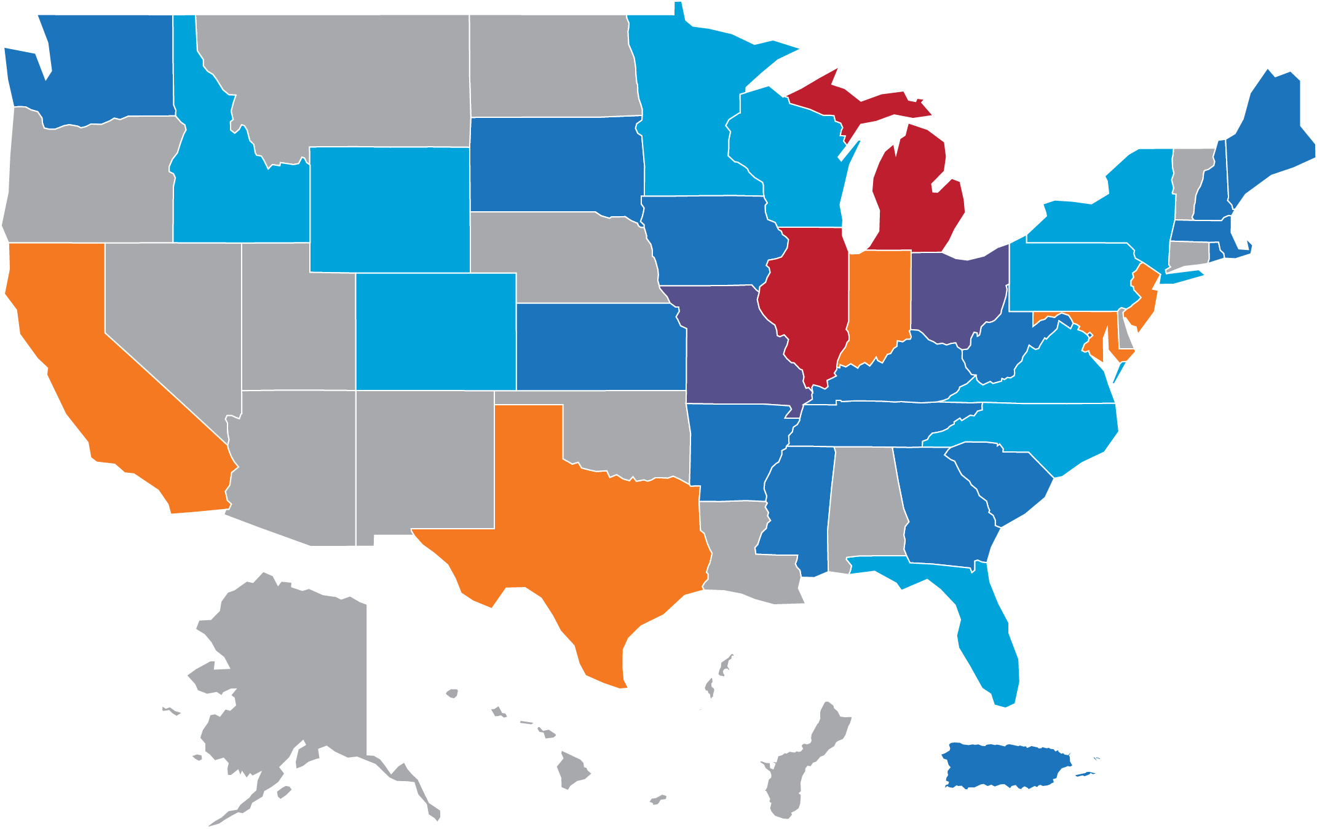

NATIONAL APPRENTICESHIP WEEK
2023 By the Numbers
1,845 Activities
472 Proclamations
1,373 Events
The 10th Annual National Apprenticeship Week (NAW) will take place from
November 18-24, 2024!
The theme of this year's celebration is "National Apprenticeship Week: 10 years of Engagement Expansion, and Innovation."
NAW is a nationwide celebration that brings together business leaders, career seekers, labor, educational institutions, and other critical partners to demonstrate their support for apprenticeship.
Get involved by hosting or attending an event or signing and submitting a proclamation!
Events Across the U.S. States and Territories
States/Territories: All NAW Events
1-10
11-20
21-30
31-50
51-100
101+
Visit www.apprenticeship.gov/NAW for resources!

Slide 20


APPRENTICESHIP.GOV OVERVIEW
  The U.S. Department of Labor launched Apprenticeship.gov in 2018 as the one-stop source for all things apprenticeship.
The site is designed to connect career seekers, employers, sponsors, educators, and training providers to the resources and tools they need to learn about apprenticeship and take-action finding an apprenticeship, starting an apprenticeship program, or becoming a participating training provider.​

Slide 21


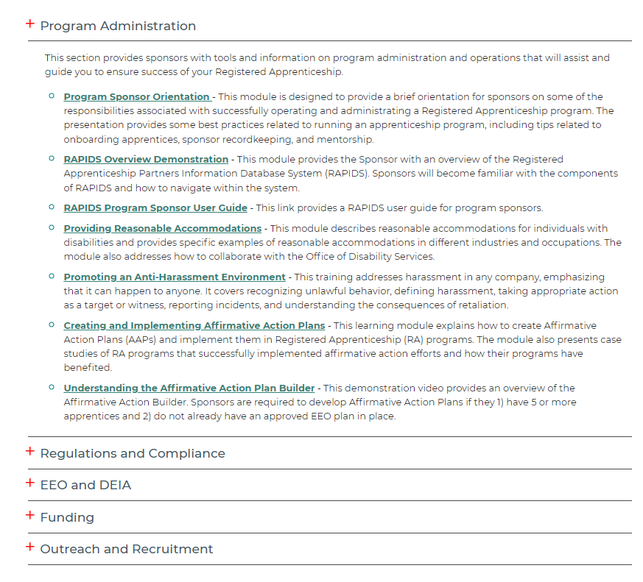

The Registered Apprenticeship Academy is an interactive learning hub designed to inform, educate, and assist Registered Apprenticeship Stakeholders succeed in their respective roles by providing vital learning pathways that are accessible, impactful, and relevant.

Slide 22
ALL ACTIVE APPRENTICESHIP INVESTMENTS
2023 Apprenticeship Building America (ABA) Grant Program ($95 million)
2023 State Apprenticeship Expansion Formula Grants ($100 million)
State Apprenticeship Expansion Formula Grants ($65 million)
Expansion of Registered Apprenticeship Programs through Industry Intermediary ($17 million)
Scaling Apprenticeship Readiness Across the Building Trades ($20 million)
2023 Women in Apprenticeship in Nontraditional Occupations (WANTO) Technical Assistance (TA) Grant Program ($5 million)
2022 WANTO Technical Assistance (TA) Grant Program ($3.4 million)
Apprenticeship Building America (ABA) Grant Program ($121 million)
Expansion of Registered Apprenticeship Programs through Industry Intermediary Services ($8 million)
2021 WANTO Technical Assistance (TA) Grant Program ($3.3 million)
State Apprenticeship Expansion, Equity, and Innovation Grants (Over $99 million)
Registered Apprenticeship Technical Assistance Centers of Excellence ($31 million)
2020 WANTO Technical Assistance TA Grant Program ($4.1 million)
Industry Intermediary Contracts ($30 million)
2020 State Apprenticeship Expansion Grants ($81 million)
Youth Apprenticeship Readiness Grants ($42.2 million)
Apprenticeship: Closing the Skills Gap Grants
($100 million)
Apprenticeship State Expansion Grants ($73 million)
Youth Apprenticeship Intermediary Contracts ($7.7 million)
Scaling Apprenticeship Through Sector-Based Strategies Grants ($183.8 million)
VISIT
https://www.apprenticeship.gov/open-funding-opportunities for more information.

Slide 23



Part 1: Introduction
Notes:
The Healthcare Career Advancement Program (H-CAP) is a national labor/management organization that promotes innovation and quality in healthcare career education.
Apprenticeship Intermediary, we help to build, launch, and run apprenticeship programs in collaboration with other apprenticeship partners. Other Intermediaries for other industries, happy to connect you.
Apprenticeship Ambassador, we are committed to promoting and expanding awareness of the benefits of Registered Apprenticeship for creating opportunities for good jobs.
Promote and expand awareness of the benefits of Registered Apprenticeship in the U.S. for industry, employers, career seekers, educators, and communities as a whole;
Identify and scale innovative practices and partnerships to modernize, strengthen, and accelerate the adoption of Registered Apprenticeship;
Increase access and support for underrepresented and underserved populations in Registered Apprenticeship including women, youth, people of color, rural communities, justice-involved individuals, and people with disabilities; and
Communicate the business case for Registered Apprenticeship as a mainstream workforce strategy for high-demand industries and creating opportunities for good jobs for all Americans across the economy

Slide 24
Apprenticeable Occupations
Part 1: Registered Apprenticeship Basics
Behavioral Health
  Peer Support
  Substance Use Disorder Professional
  Licensed Addiction Counselor
  Behavioral Health Tech
  Community Health Worker

Slide 25

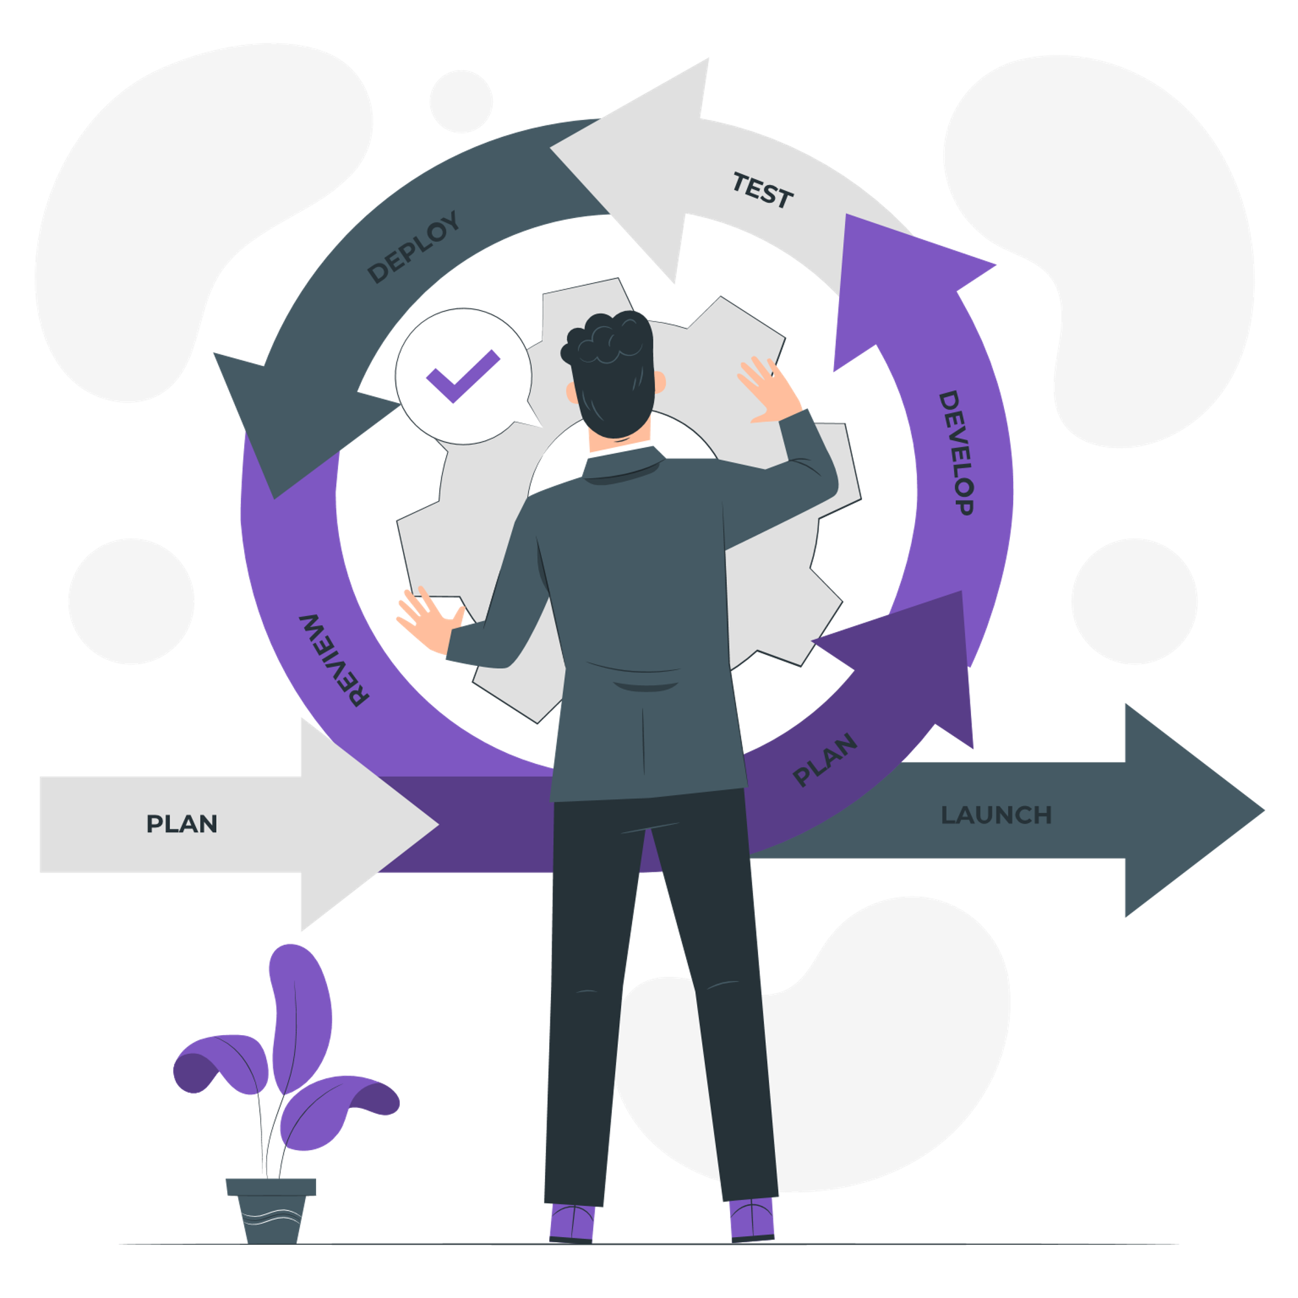





The Apprenticeship Essentials
Industry Led
Supplemental Education
Quality and Safety
Structured,
On-the-Job Learning and Mentorship
Diversity
Paid Job
Credentials

Slide 26
Industry Led
Healthcare employers play an active role in hiring workers and identifying the skills and knowledge apprentices must learn.
Supplemental Education
Quality and Safety
Structured,
On-the-Job Learning and Mentorship
Diversity
Paid Job
Credentials

Slide 27
Industry Led
Supplemental Education
Quality and Safety
Structured,
On-the-Job Learning and Mentorship
Diversity
Paid Job
Registered Apprenticeships are real jobs! Apprentices earn progressive wage increases as their skills and productivity increase.
Credentials

Slide 28
Supplemental Education
Apprentices are provided a minimum of 144-hour supplemental classroom education based on the employers’ unique training needs to ensure quality and success.
Quality and Safety
Industry Led
Structured,
On-the-Job Learning and Mentorship
Diversity
Paid Job
Credentials

Slide 29
Structured,
On-the-Job Learning and Mentorship
Programs provide a minimum of 2000 hours of structured on-the-job training to prepare for a successful career, which includes instruction from an experienced mentor. The number of hours may vary based on the apprenticeship model.
Industry Led
Supplemental Education
Quality and Safety
Paid Job
Credentials
Diversity

Slide 30
Industry Led
Supplemental Education
Quality and Safety
Paid Job
Structured,
On-the-Job Learning and Mentorship
Diversity
Credentials
Apprentices earn a portable, nationally-recognized certificate from the USDOL. Additionally, apprentices may earn industry recognized certification or license.

Slide 31
Industry Led
Supplemental Education
Quality and Safety
Paid Job
Structured,
On-the-Job Learning and Mentorship
Credentials
Diversity
Programs are designed to reflect the communities in which they operate through strong non-discrimination, anti-harassment, and recruitment practices to ensure access, equity, and inclusion.

Slide 32
Quality and Safety
Apprentices are afforded worker protections while receiving rigorous training to equip them with the skills they need to succeed and the proper training and supervision they need to be safe.
Supplemental Education
Industry Led
Structured,
On-the-Job Learning and Mentorship
Diversity
Paid Job
Credentials

Slide 33

Apprentice Success
https://youtu.be/zHkn70oRBDA

Slide 34






HOW CAN H-CAP HELP YOU
Incentive Funding
Partnership Building
Customized Program
Host Events
Free Technical Assistance
Recruitment & Retention

Slide 35
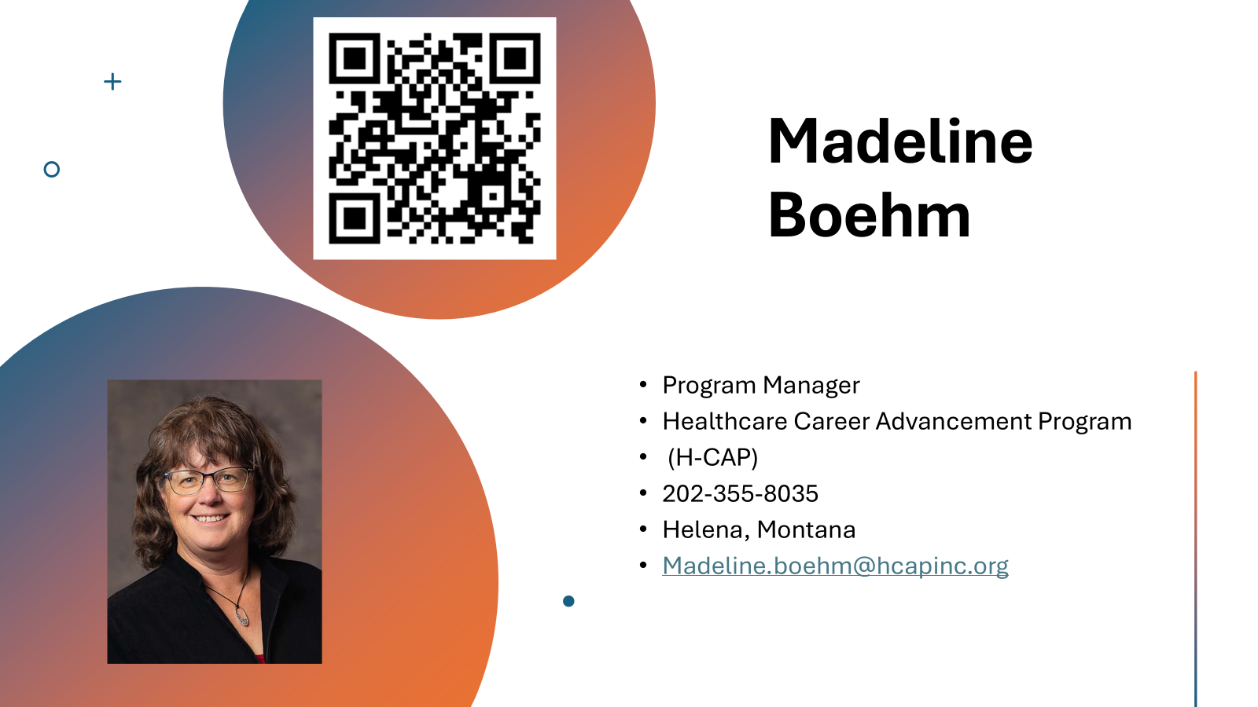

Slide 36
Q&A:

Slide 37
Stay Engaged with the Center for Workforce Solutions
  Email us at workforce@thenationalcouncil.org
Register for the Workforce Solutions Jam: A free, monthly public webinar to build national momentum through highlighting workforce innovations and updates from the field.
Visit the Center for Workforce Solutions webpage
Subscribe to our newsletter for webinars and future CWS engagement opportunities.

